Slide 1
Electric bikes (E-Bike)

Slide 2
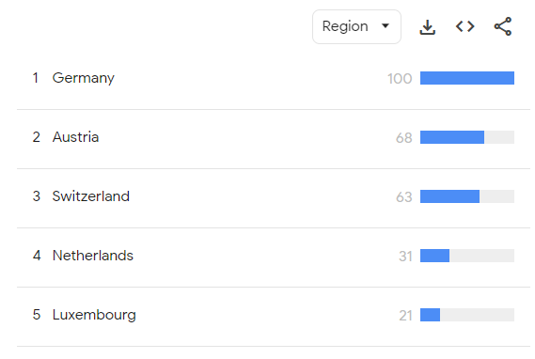
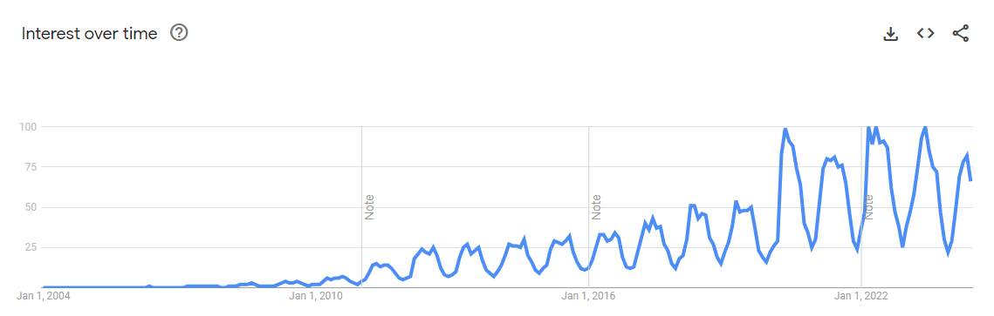
The electric bikes market is experiencing significant growth due to increasing environmental awareness and the shift towards sustainable transportation options. Rising fuel prices and advancements in battery technology also drive this trend.
Chosen country: Germany
Using Google Trends, Germany shows a high interest in electric bicycles, with consistent search volume over the past 5 years. The country is known for its cycling culture, environmental awareness and infrastructure for bicycles.
Search: “E-Bike”
Worldwide, 5 years
Search: “E-Bike”
Germany, 2004 - onwards

Slide 3
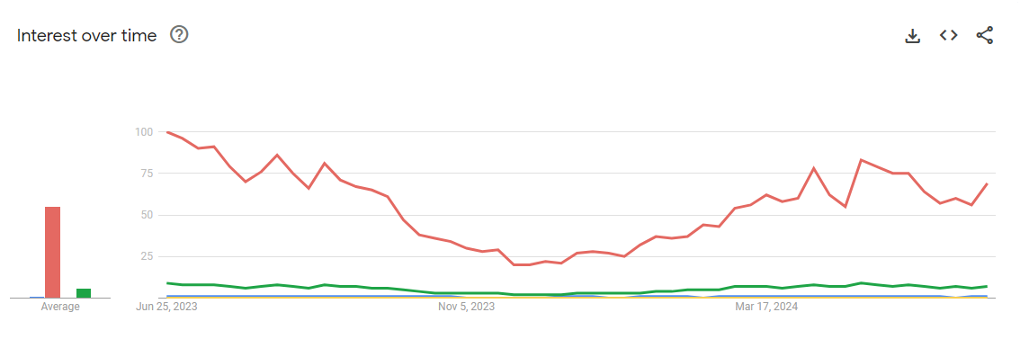
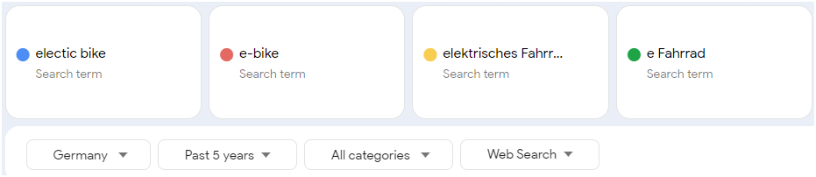
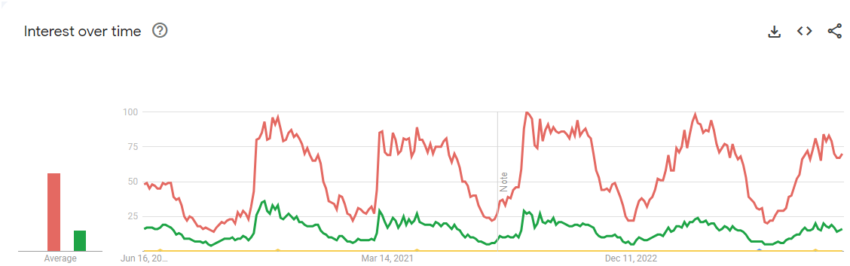
Search trends clearly show that full phrase of “Electric bike” both in english and german is not being searched widely, while shortened “E-Bike” work really well both in english and german. Of course bike is a seasonal product, that’s why we see such big movements every year - peaking in summer and spring.
Past 12 months

Slide 4
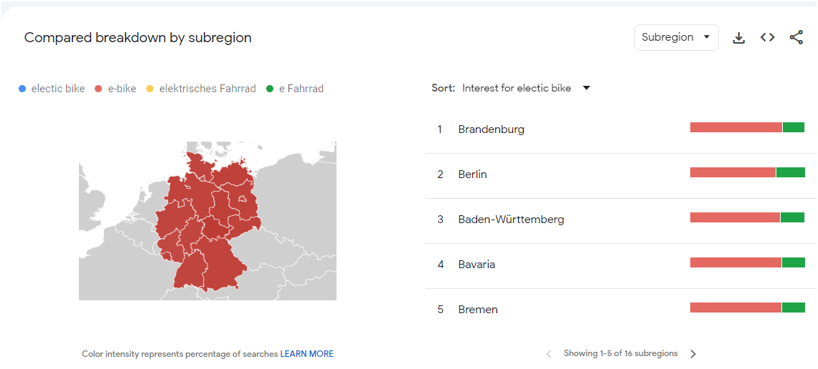
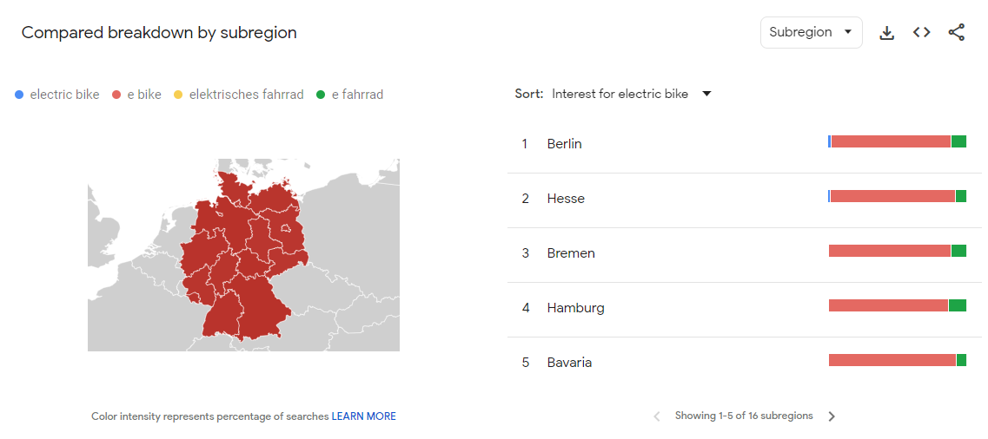
If we compare keywords used in different regions we don’t see much difference, “e-bike” and “e-Fahrrad” dominate throughout whole Germany.
The only difference we see in the last 12 months trends is that keyword “electric bike” now has 3% interest in Berlin and 2% in Hesse, this might indicate it’s worth spending more on this keyword in some specific regions.

Slide 5
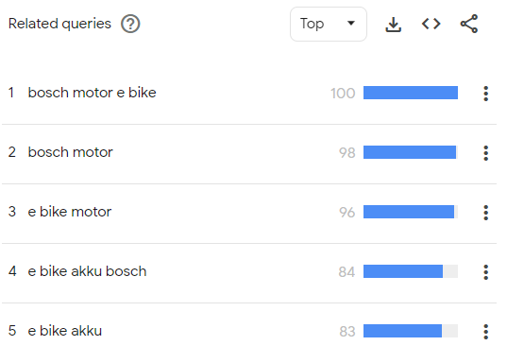
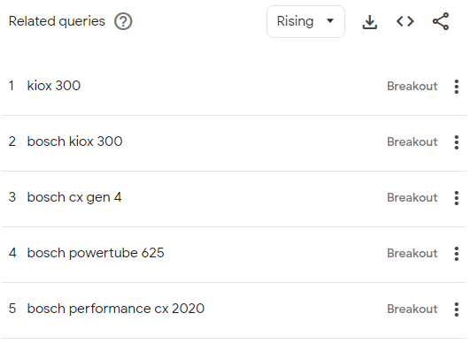
Top Competitors
Bosch eBike Systems: Leading in technology and brand recognition, high search volume. Focuses on advanced e-bike technology, components, and partnerships with various bike manufacturers.
Market position: Strong technological edge and well known partnerships.
Top searches show more general e-bike phrases, while rising searches show specific models, that are not only e-bikes, but mostly e-bike accessories.

Slide 6
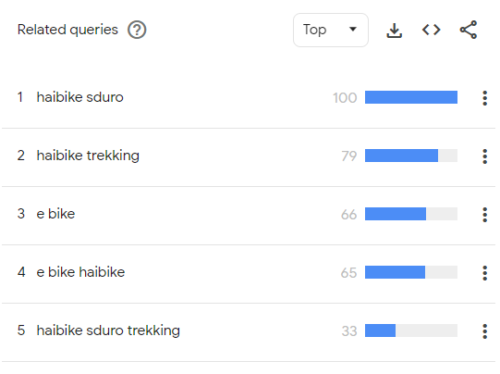
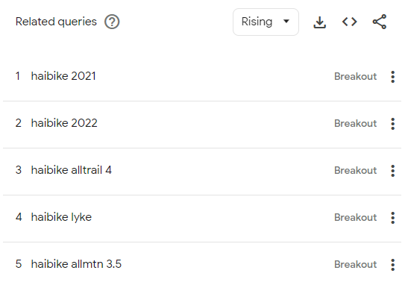
Top Competitors
Haibike: Popular for performance and mountain e-bikes, high search interest in areas with outdoor sports enthusiasts. Though the interest is fading year over year.
Market position: Performance-driven, appealing to sports enthusiasts.
Top searches show specific e-bike models, that might indicate that the audience know what they’re searching for and they are more likely to buy instead of just search, same goes with rising searches.

Slide 7
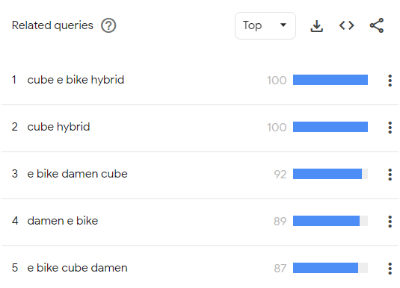
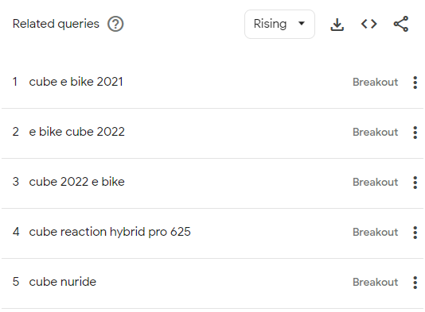
Top Competitors
Cube Bikes: Offers a wide range of models from city bikes to mountain bikes, appealing to a diverse customer base, stable search interest across the country.
Market position: Broad market reach with a variety of models. (They offer regular bikes as well, what makes the brand more known for bike enthusiasts)
Top searches show specific e-bike models, that might indicate that the audience know what they’re searching for and they are more likely to buy instead of just search, same goes with rising searches.

Slide 8
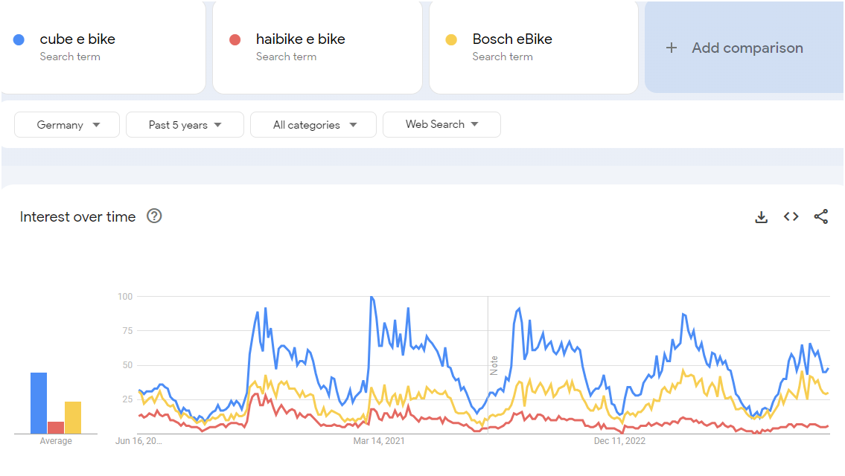
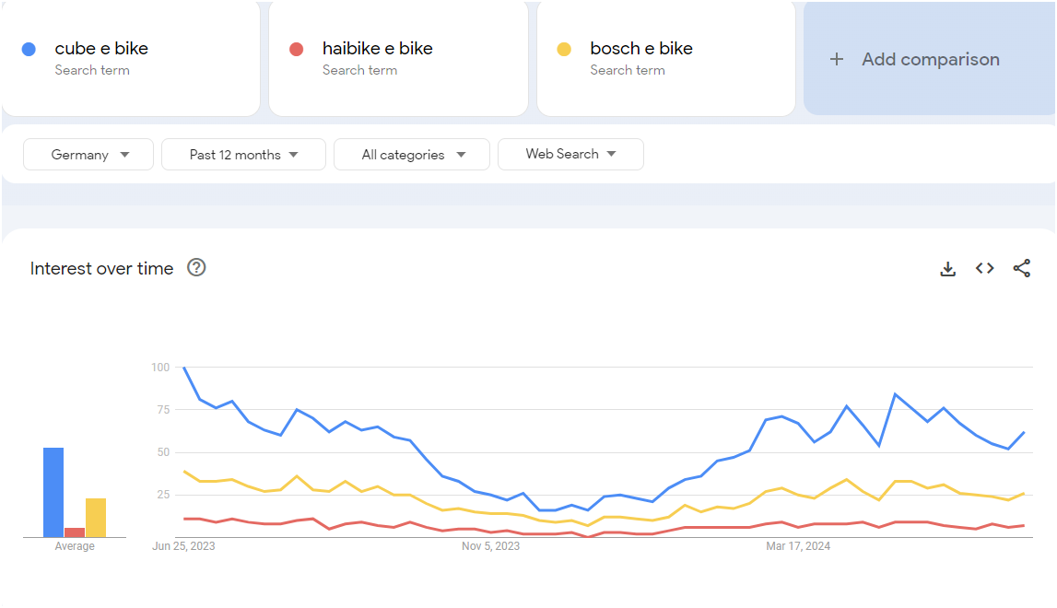
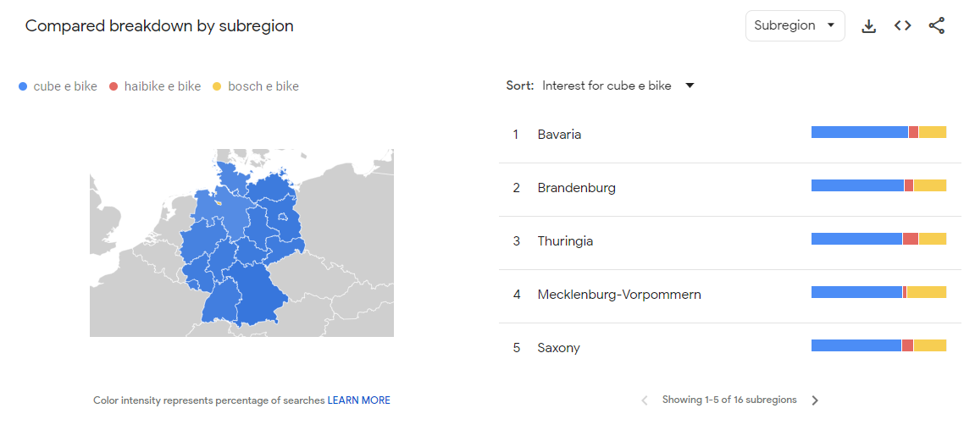
We can clearly see how Cube E-Bikes are consistently on top of searches for E-Bikes, thought in the recent years Bosch seems to be catching up.

Slide 9
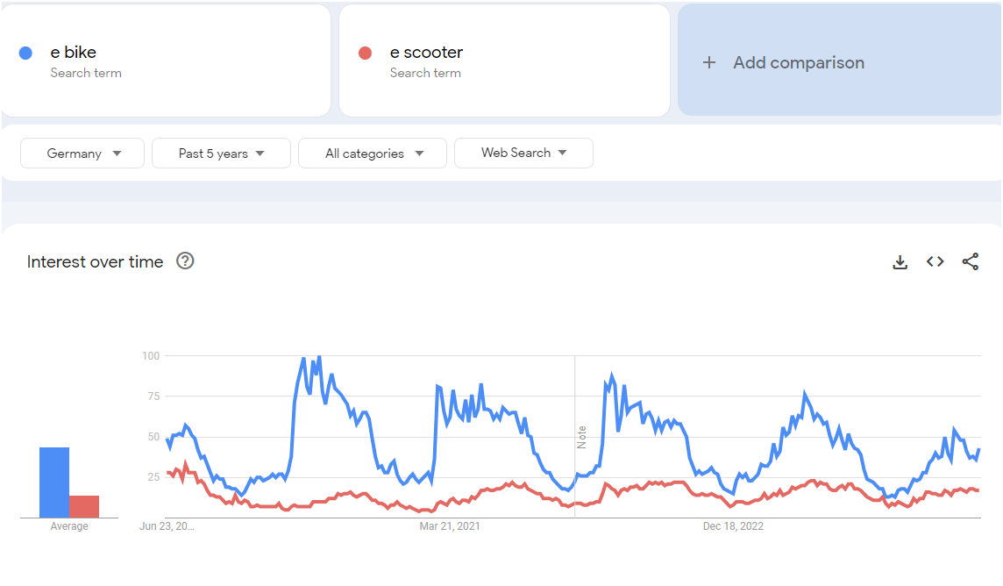
E bike and E scooter comparison as these 2 are the most similar vehicles
Rising Terms:
"E-bike subsidies Germany" - indicates government incentives driving market growth.
"Best electric bike 2024" - consumers are actively seeking the latest models.
"Electric bike battery life" - concerns about range and durability.

Slide 10
Launch Strategy
Product Positioning:
Highlight key features such as battery life, durability, and performance.
Position as a sustainable and cost-effective alternative to traditional transportation.
Marketing Strategy:
Focus on urban centers like Berlin, Hamburg, and Munich.
Emphasize government subsidies and environmental benefits.
Launch targeted ad campaigns during spring and summer.

Slide 11
Launch Strategy
Strategy:
Differentiate from competitors by offering innovative features and competitive pricing.
Form partnerships with local bike shops and cycling communities.
Long-Term Development:
Monitor Google Trends to stay updated on emerging terms and consumer interests.
Expand product lines based on seasonal and regional demand.
Continuously improve technology and customer service based on feedback and market trends.

